Slide 1
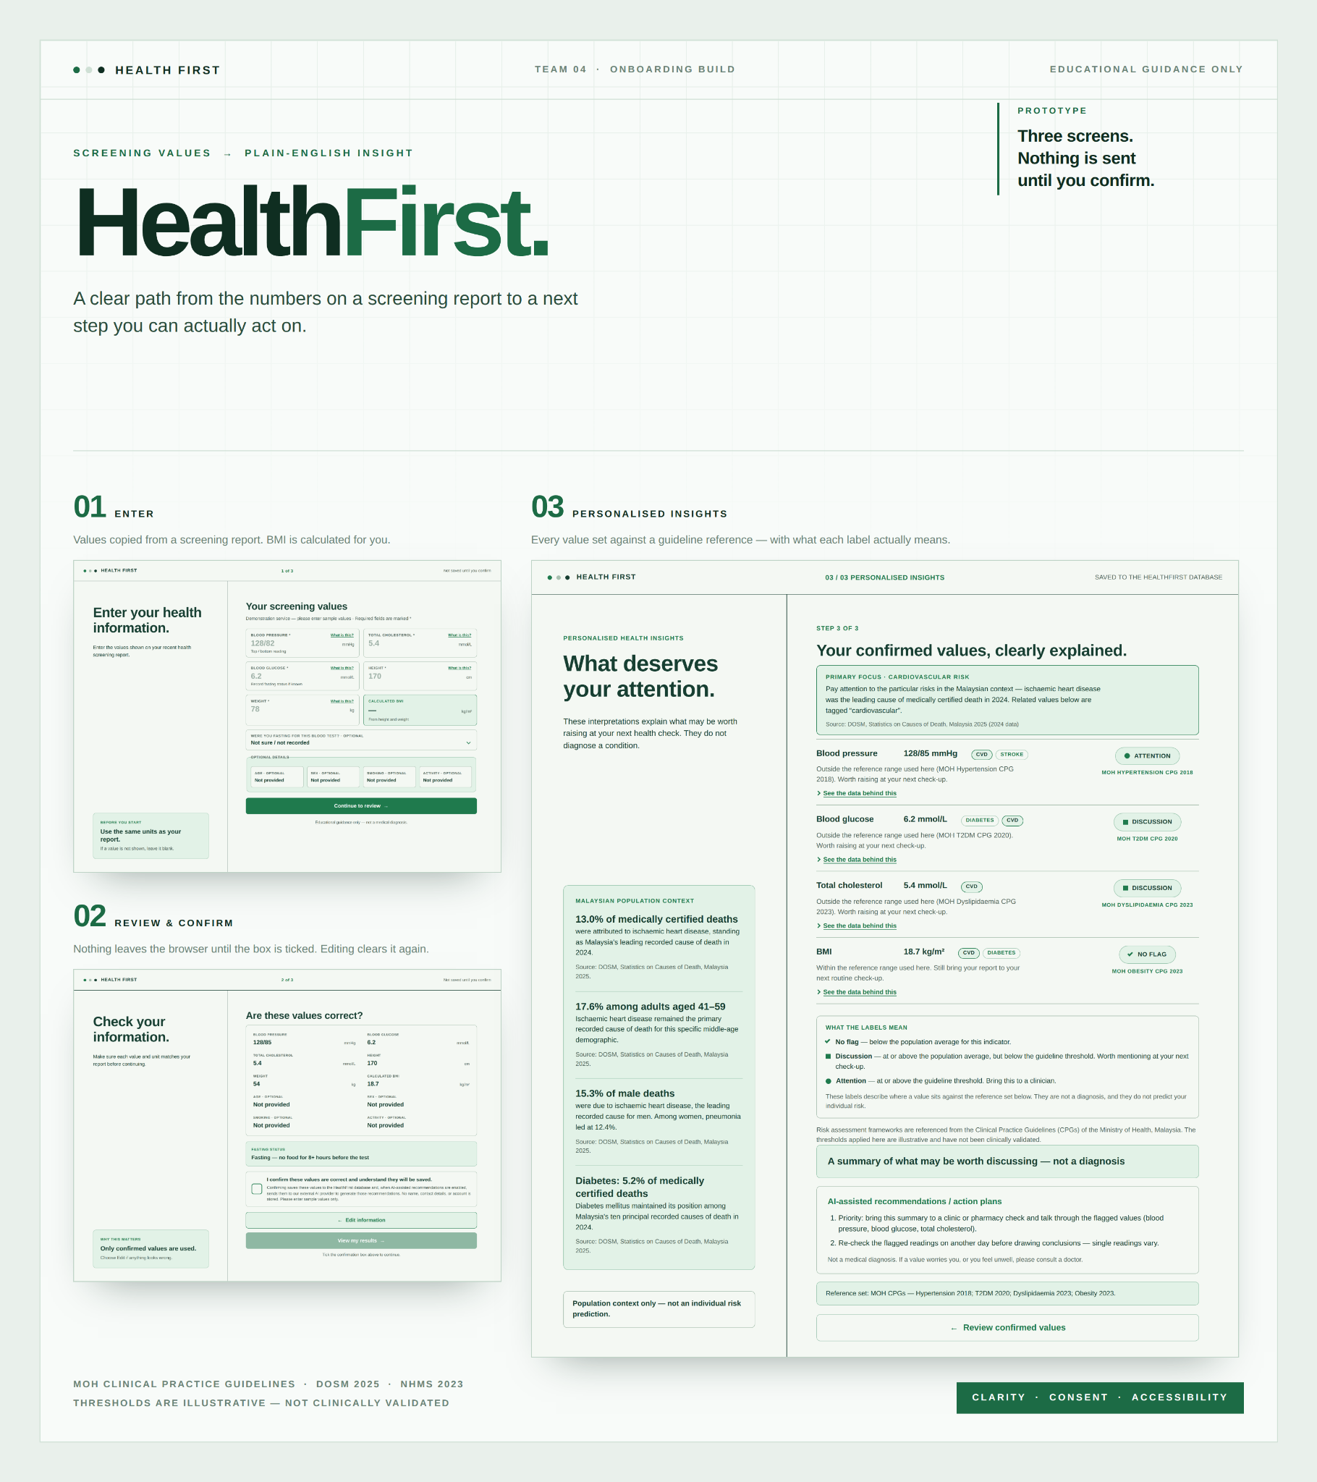
TM04 Onboarding Project
HealthFirst
Huang Guan - Project Manager
Hnin Darli - Data Analyst
Qian Jiang - UI/UX / Frontend
LiHanXia - Backend
Keith Junn Chong - Database
Benshuai - AI / LLM

Slide 2

Problem statement
Middle-Aged Malaysians Complete Health Screenings
BUT Cannot Act on the Results
1 in 2
Written for doctors, not patients
Reports list values and ranges, not meaning
Malaysian adults with high cholesterol do not know they have it
Statistics feel distant
National data describes populations, not people
NHMS 2023, Ministry of Health Malaysia
13% Ischaemic Heart Disease
The effort does not last
They search, join a gym, watch their diet — then it fades
Top 1 Principal Cause of Death

Slide 3
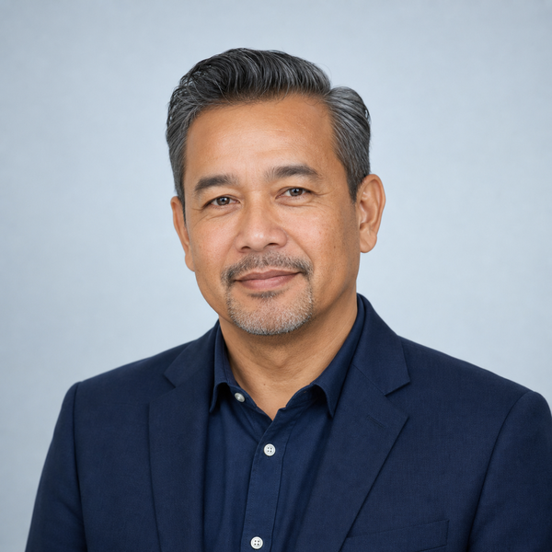
User Persona
“The doctor went through everything, but there was too much to remember. I have the report — I just don’t know what to do with it.”
Target user: has the numbers, not the meaning
Screened but Unsupported
Frustrations
1
Cannot tell which numbers on the report matter, or which ones may require further attention.
Searching online and asking friends returns scattered, conflicting answers.
2
Lim Wei Jian, 48, Kuala Lumpur
3
National statistics feel distant — “heart disease is the leading cause of death, but what does that mean for me?”
Operations manager, married, two teenage children
Rarely exercises, eats irregularly, sleeps late
Just completed his company’s annual screening
Cannot recall what the doctor explained
Friends his age recently diagnosed with heart disease
Motivations
1
Staying well enough to enjoy retirement with his family, without becoming dependent on others.
He finally has real numbers in hand and wants to use them before problems appear.
2

Slide 4
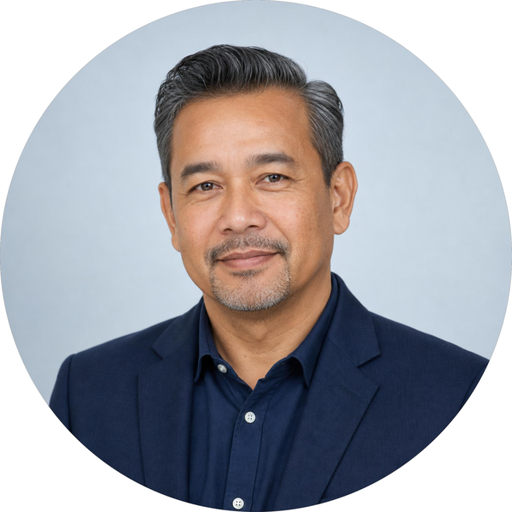






Empathy Map
Mr Lim Wei Jian, 48
Operations manager, Kuala Lumpur
Two teenage children · rarely exercises
Mr Lim, in the weeks after his annual screening
“I don’t know where to start.”
WHAT WE WANT FOR HIM
Understand which results need his attention — and take one appropriate next step.
SEE
SAY
DO
HEAR
Numbers flagged in red
Search results that contradict
Peers watching their health
“I’m fine, nothing serious”
Honest with his wife about it
Searches his values online
Supplements, gym, diet
Then attempts fade slowly
Doctor: “keep an eye on it”
Everyone else: eat better, exercise
TODAY PAINS
GAINS WITH HEALTHFIRST
→
Doesn’t know which numbers matter
More anxious after the screening than before it
No symptoms, so the urgency fades
Knows which results need attention
A few clear, prioritised next steps
Stays well enough to enjoy retirement

Slide 5
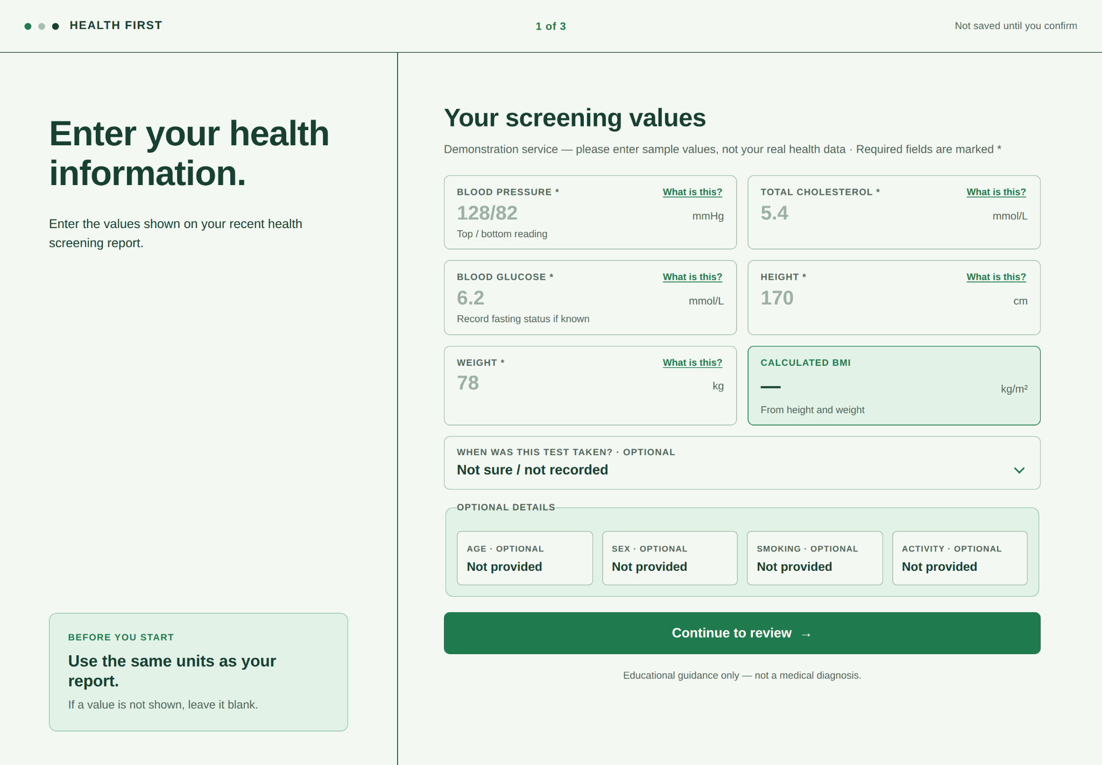
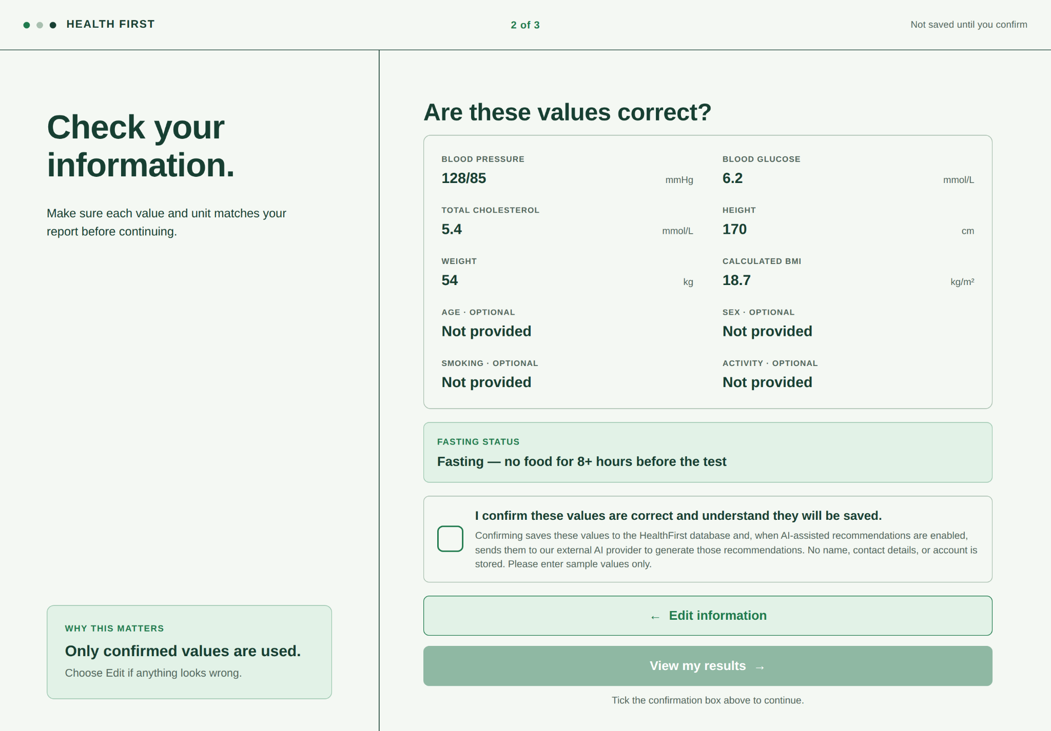
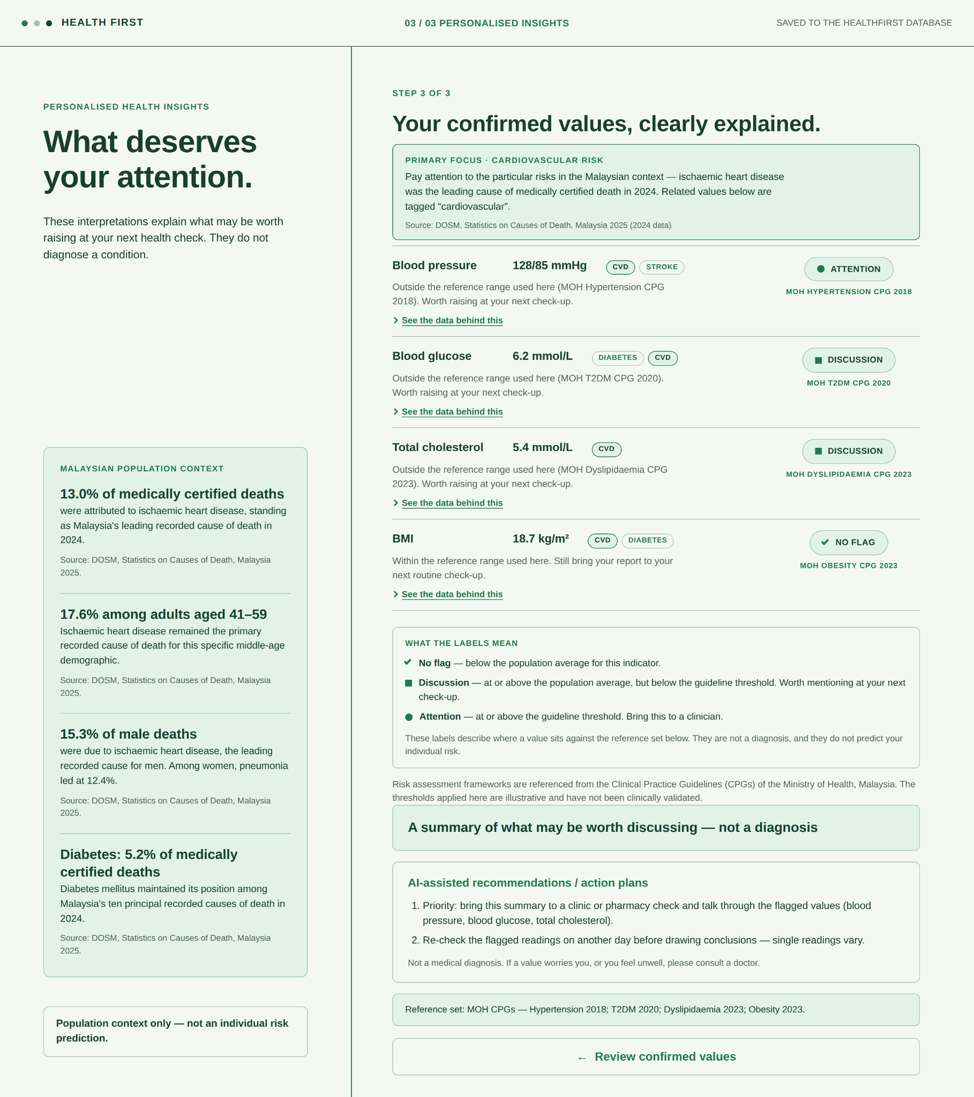
Solution
HealthFirst: makes your screening numbers mean something — and worth acting on.
The Challenge
Our Solution
Written for doctors, not patients
→
Personalised health insights
Reports list values and ranges, not meaning
Transform confirmed health information into understandable personalised insights
Statistics feel distant
→
Malaysian health context
National data describes populations, not people
Connect relevant findings with Malaysian health statistics so users understand why it matters
The effort does not last
→
Prioritised preventive action
They search, join a gym, watch their diet — then it fades
Clear, relevant and prioritised preventive actions, and when professional follow-up may be appropriate
4 MAIN HEALTH FOCUS
Cardiovascular disease
Stroke
Diabetes
Heart failure

Slide 6
Epics and User Stories for the Build-up
EPIC 1
EPIC 2
EPIC 3
Difficulty Understanding Health Screening Results
Uncertainty of Personal Health Risks
Uncertainty of Prioritised Preventive Action
US 1.1
US 2.1
US 3.1
Provide Health Screening Information
Understand My Health Results and Risks
Receive Prioritised Preventive Actions
US 1.2
US 2.2
US 3.2
Review and Confirm Health Information
Understand My Health in the Malaysian Context
Understand Professional Follow-Up
MUST HAVE
MUST HAVE
MUST HAVE

Slide 7
Link to HealthFirst : click here

Slide 8
Feature 1 : Enter Health Screening Values

Slide 9
Feature 2 : Review and Confirmation of User Input

Slide 10
Feature 3 : Personalized Risk Assessment with Malaysian Population Context

Slide 11
Open Data
DATA SOURCES
01
Cardiovascular Disease (70k)
05
Causes of Death Malaysia 2025
BP, cholesterol, glucose, BMI — main comparison benchmark
Official leading causes by sex & ethnicity — mortality context
02
Diabetes Prediction
06
Deaths by District & Sex
BMI, HbA1c, glucose, hypertension — diabetes risk support
District-level death counts & rates — local demographic context
03
Heart Failure Prediction
07
Annual Deaths (National)
RestingBP, Cholesterol, FastingBS — heart failure risk support
National death totals — baseline mortality volume
Stroke Prediction
USER INPUT
Manual values (MVP); report upload/OCR pending
NORMALISED FIELDS
Blood pressure, cholesterol, glucose, BMI
CONTEXT TABLES
Approved Kaggle datasets + Malaysian mortality sources
OUTPUT
Risk signal -> summary -> action card
04
Hypertension, glucose, BMI — stroke risk support

Slide 12
References
Department of Statistics Malaysia (DOSM). (2025). Statistics on Causes of Death, Malaysia 2025. https://www.dosm.gov.my/portal-main/release-content/statistics-on-causes-of-death-malaysia-2025
OpenDOSM. Deaths by District & Sex. https://open.dosm.gov.my/data-catalogue/deaths_district_sex
Kaggle datasets used in the project: cardiovascular disease, diabetes, heart failure and stroke. Dataset source links are recorded in the project notes.

Slide 13
THANK YOU
Questions & Discussion

